Slide 1
Current project: Drone Handover message generation
Data augmentation
DL+NLG model

Slide 2
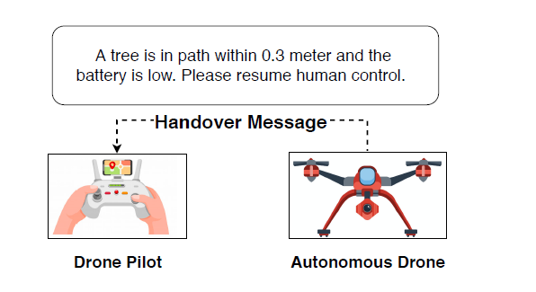
Handover message is generated to assist human pilots in performing dedicated task. It should verbalizes messages from sensor data records in order to perform a controlled handover to a human drone pilot
Drone Handover message generation

Slide 3
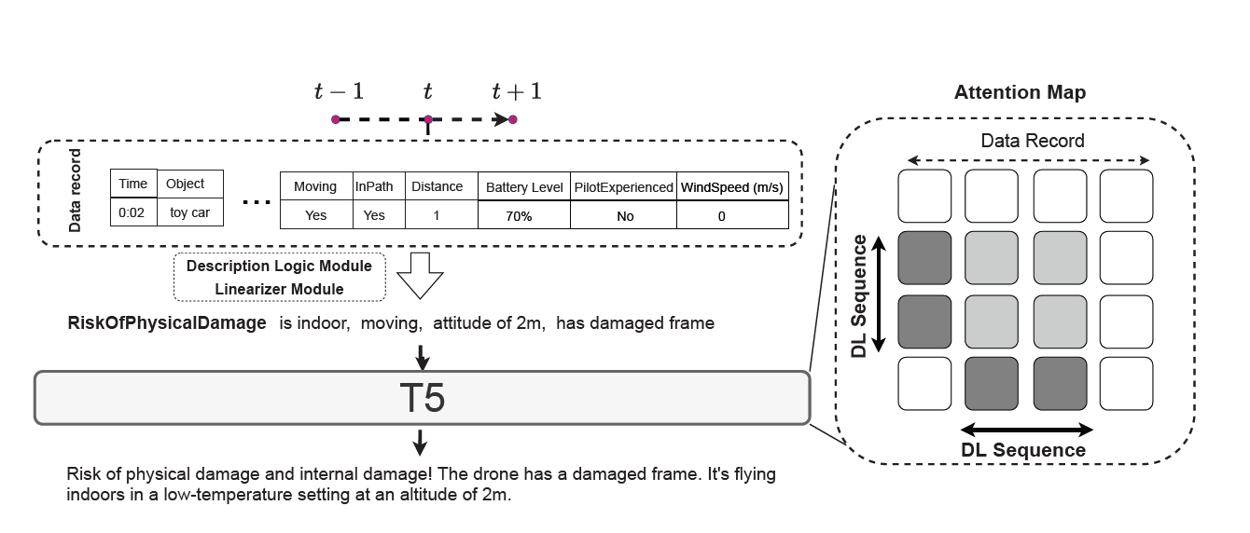
Novelty: 1. Collects the Drone Sensor Data dataset. 2. Uses Description logic (DL) as content selection module. 3. Trains a T5 model to rewrite the template into a human-readable sentence.
Previous work: Logic-Guided Message Generation from Raw Real Time Sensor Data

Slide 4
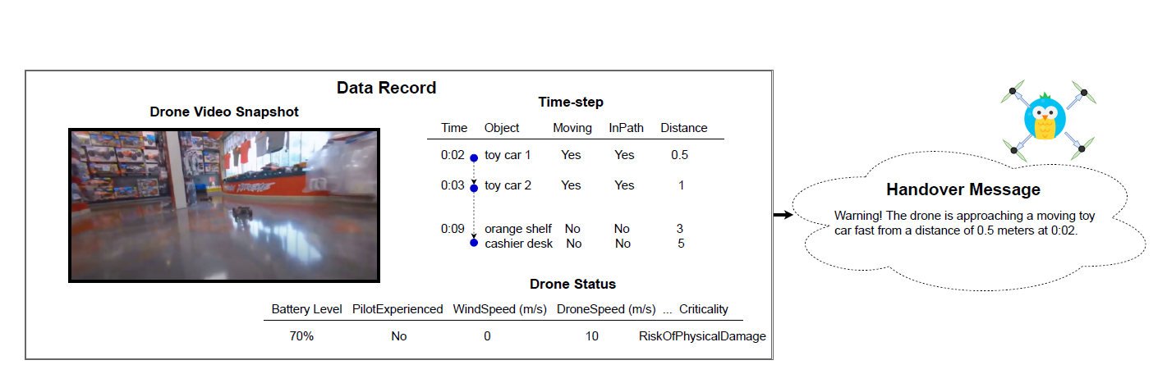
1. The sensor data is structured -> data2text generation 2. The sensor data is redundant -> content selection 3. The handover utterances is diverse -> train a neural generation model
Drone Sensor Data dataset

Slide 5
Description Logic as content selection
Sensor Data
Descriptoin Logic
@abc.abstractmethod
def description_logic(data):
pass
Relevant sensor records
Linearized message

Slide 6
Description Logic
name | ID_obj | Type | Moving | InPath | Distance | time_stamp | Link
person with a controller | 1 | Human | FALSE | FALSE | 8 | 0:00 | https://drive.google.com/file/d/1oJ6t-VJN3rAmslsXszkVUzTZl4LJujeM/view?usp=sharing
gravestone 1 | 2 | Object | FALSE | TRUE | 3 | 0:01 | https://drive.google.com/file/d/1oJ6t-VJN3rAmslsXszkVUzTZl4LJujeM/view?usp=sharing
gravestone 2 | 3 | Object | FALSE | TRUE | 3 | 0:01 | https://drive.google.com/file/d/1oJ6t-VJN3rAmslsXszkVUzTZl4LJujeM/view?usp=sharing
castle | 4 | Building | FALSE | FALSE | 5 | 0:01 | https://drive.google.com/file/d/1oJ6t-VJN3rAmslsXszkVUzTZl4LJujeM/view?usp=sharing
castle | 4 | Building | FALSE | TRUE | 1 | 0:05 | https://drive.google.com/file/d/1oJ6t-VJN3rAmslsXszkVUzTZl4LJujeM/view?usp=sharing
DL Query
very_close_human：
[ rdf:type owl:Restriction ;
owl:onProperty <http://www.semanticweb.org/alisa/ontologies/2021/3/veryClose> ;
owl:someValuesFrom <http://www.semanticweb.org/alisa/ontologies/2021/3/Human> ;
rdfs:subClassOf <http://www.semanticweb.org/alisa/ontologies/2021/3/RiskOfHumanDamage>
]
Content Selection
DL Linearizer
name | Distance | time_stamp
person with a controller | 8 | 0:00
"(0:00) The drone is flying very close to a human at a distance of 8m, and might cause human injury."

Slide 7
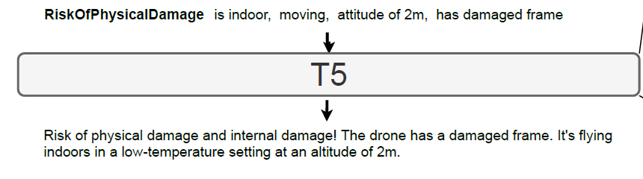
T5
DL-to-text rewriter:
transforms the linearized
sequence into a human-readable sentence

Slide 8
Limitations: 1. Manually collected data with only 316 data records. 2. Limited DL queries 3. Lack of extensibility to multi-modal setting (since the dataset contains snapshot videos for each data record)
Previous work: Logic-Guided Message Generation from Raw Real Time Sensor Data

Slide 9
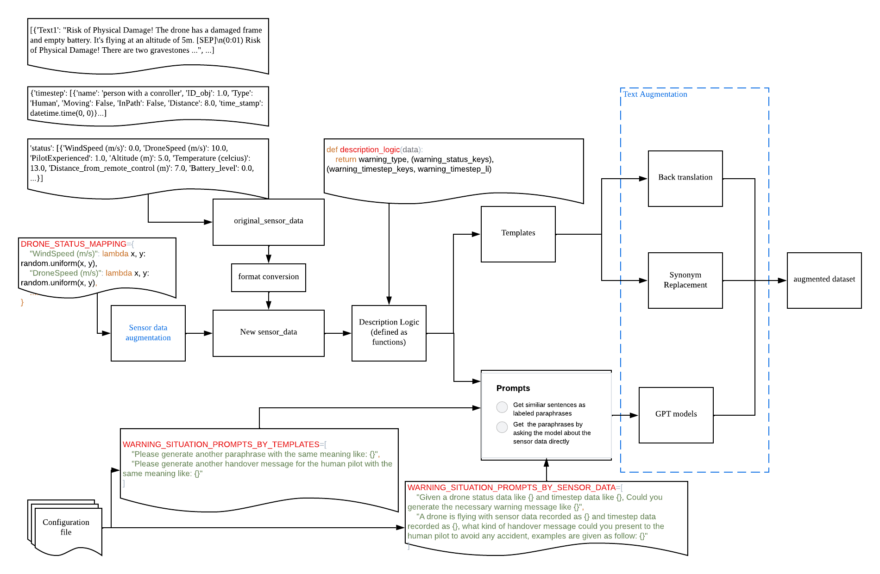
Data augmentation
Sensor data Augmentation
Text Augmentation
Back translation
Synonym Replacement
Prompt-based learning

Slide 10
Sensor data Augmentation
DRONE_STATUS_MAPPING={
"WindSpeed (m/s)": lambda x, y: random.uniform(x, y),
"DroneSpeed (m/s)": lambda x, y: random.uniform(x, y),
….
"weather": lambda x: random.choice(x)
}
“WindSpeed (m/s)”: lambda x, y: random.uniform(0, 10),
"DroneSpeed (m/s)": lambda x, y: random.uniform(0, 20),
….
"weather": lambda x: random.choice(['sunny', 'gloomy', 'dark', 'sandy', 'rainy', 'snowy', 'windy’])
DRONE_STATUS_PARA_MAPPING_RURAL={
"WindSpeed (m/s)": (0, 10),
"DroneSpeed (m/s)": (0, 20),
….
weather": (['sunny', 'gloomy', 'dark', 'sandy', 'rainy', 'snowy', 'windy'])
}
WindSpeed (m/s) | DroneSpeed (m/s) | … | weather
0 | 10 | … | sunny
Notes:
Define the distribution of each column in the dataset, and randomly generate data from the distribution

Slide 11
Text augmentation
There is a risk of physical damage!Drone air batteries fly.The framework is also damaged and the height is 5m.
(0:01) The risk of physical damage!There are two tombstones 3m, in the path of the drone.
(0:05) The risk of physical damage! The drone is flying towards the castle with only 1m far.
Text Example:
Risk of physical damage! The drone is flying with an empty battery. The frame is also damaged and the altitude is 5m. [SEP]
(0:01) Risk of physical damage! There are two gravestones 3m away and in the drone's path. [SEP]
(0:05) Risk of physical damage! The drone is flying toward a castle in its path which is only 1m away. [SEP]
Back translation
There is a risk of physical damage!Drone air batteries fly.The framework is also damaged and the height is 5m.
(0:01) The risk of physical damage!There are two tombstones 3m, in the path of the drone.
(0:05) The risk of physical damage! The drone is flying towards the castle with only 1m far.
Synonym
replacement

Slide 12
Prompt-based augmentation
1. Manually create prompt templates:
["Given a flying drone status data like '{}' and timestep data like '{}', Could you generate a handover message with only necessary crucial information like '{}'",
"A drone encountered some crucial situations and needed to hand the manipulation over to the human pilot. The related drone status data was recorded as '{}', and timestep data was recorded as '{}'. What kind of handover message could we present to the human pilot to avoid any accidents? An example is given as follows: '{}'.",
"A flying drone encountered an emergency and needed to be handover to a human pilot. The emergence-related status data is recorded as '{}', and related timestep data is recorded as '{}'. Please generate the handover message for the human pilot that is similar to the example '{}'",
"Related drone status data: '{}'; Related timestep data: '{}', Handover message example: '{}', please generate another handover message for the human pilot after colon:",
]

Slide 13
Prompt-based augmentation
2. Fill the template with sensor data:
["Given a flying drone status data like {"Normal_frame": false} and timestep data like {"reachable_inpath": [{"time_stamp": "0:01", "name": "gravestone 1", "Distance": 3.0}, {"time_stamp": "0:01", "name": "gravestone 2", "Distance": 3.0}, {"time_stamp": "0:05", "name": "castle ", "Distance": 1.0}]}, Could you generate a handover message with only necessary crucial information like The flying drone is runing out of battery with only 0% charge. The drone is flying with a damaged frame. (0:01) The drone is facing the risk of physical damage. There is a gravestone 1 in the drone's flight path at a distance of 3.0m. (0:01) The drone is facing the risk of physical damage. There is a gravestone 2 in the drone's flight path at a distance of 3.0m. (0:05) The drone is facing the risk of physical damage. There is a castle in the drone's flight path at a distance of 1.0m”
.….
]

Slide 14
Prompt-based augmentation
3. Evaluate the response from generation model:
1. BLEURT score, similarity between the response and the annotated text
2. Human evaluation:
1. Naturalness (0-5)
2. Informativeness (0-5)
3. Faithfulness (0-5)

Slide 15
Overall data augmentation performance

Slide 16
Overall data augmentation performance: Human Evaluation

Slide 17
Current Problems
Empty response (OpenAI )
Prompt: Given a flying drone status data like {"Normal_frame": false} and timestep data like {"reachable_inpath": [{"time_stamp": "0:01", "name": "gravestone 1", "Distance": 3.0}, {"time_stamp": "0:01", "name": "gravestone 2", "Distance": 3.0}, {"time_stamp": "0:05", "name": "castle ", "Distance": 1.0}]}, Could you generate a handover message with only necessary crucial information like The flying drone is runing out of battery with only 0% charge. The drone is flying with a damaged frame. (0:01) The drone is facing the risk of physical damage. There is a gravestone 1 in the drone's flight path at a distance of 3.0m. (0:01) The drone is facing the risk of physical damage. There is a gravestone 2 in the drone's flight path at a distance of 3.0m. (0:05) The drone is facing the risk of physical damage. There is a castle in the drone's flight path at a distance of 1.0m.
Response:
Solution: Use other generation model like T5 and Bart (Currently we are using GPT-3, in the hope of using ChatGPT API as soon as OpenAI release the access)
Hallucination
Truncated prompt
Notes:
Use other generation model like T5 and Bart

Slide 18
Current Problems
Empty response (OpenAI )
Hallucination
Prompt: Related drone status data: '{"Normal_frame": false}'; Related timestep data: '{"reachable_inpath": [{"time_stamp": "0:01", "name": "gravestone 1", "Distance": 3.0}, {"time_stamp": "0:01", "name": "gravestone 2", "Distance": 3.0}, {"time_stamp": "0:05", "name": "castle ", "Distance": 1.0}]}', Handover message example: 'The flying drone is runing out of battery with only 0% charge. The drone is flying with a damaged frame. (0:01) The drone is facing the risk of physical damage. There is a gravestone 1 in the drone's flight path at a distance of 3.0m. (0:01) The drone is facing the risk of physical damage. There is a gravestone 2 in the drone's flight path at a distance of 3.0m. (0:05) The drone is facing the risk of physical damage. There is a castle in the drone's flight path at a distance of 1.0m.', please generate another handover message for the human pilot after colon:
Response: 'The flying drone is running out of battery with only 10% charge. The drone is flying with a damaged frame. (10:01) The drone is facing the risk of physical damage. There is a gravestone 1 in the drone's flight path at a distance of 3.0m. (10:01) The drone is facing the risk of physical damage. There is a gravestone 2 in the drone's flight path at a distance of 3.0m. (10:05) The drone is facing the risk of physical damage. There is a castle in the drone's flight path at a distance of 1.0m.
Solution: Omit the
Truncated prompt

Slide 19
Current Problems
Empty response
Hallucination
Truncated prompt
Prompt: A drone encountered some crucial situations and needed to hand the manipulation over to the human pilot. The related drone status data was recorded as '{"Normal_frame": false}', and timestep data was recorded as '{"reachable_inpath": [{"time_stamp": "0:01", "name": "gravestone 1", "Distance": 3.0}, {"time_stamp": "0:01", "name": "gravestone 2", "Distance": 3.0}, {"time_stamp": "0:05", "name": "castle ", "Distance": 1.0}]}'. What kind of handover message could we present to the human pilot to avoid any accidents? An example is given as follows: 'The flying drone is runing out of battery with only 0% charge. The drone is flying with a damaged frame. (0:01) The drone is facing the risk of physical damage. There is a gravestone 1 in the drone's flight path at a distance of 3.0m. (0:01) The drone is facing the risk of physical damage. There is a gravestone 2 in the drone's flight path at a distance of 3.0m. (0:05) The drone is facing the risk of physical damage. There is a castle in the drone's flight path at a d..
Response: {"message":"The flying drone is running out of battery with only 0% charge. The drone is flying with a damaged frame. (0:01) The drone is facing the risk of physical damage. There is a gravestone 1 in the drone's flight path at a distance of 3.0m. (0:01) The drone is facing the risk of physical damage. There is a gravestone 2 in the drone's flight path at a distance of 3.0m.
Solution:
switch to other model that allows for more token limit
Try more prompt templates

Slide 20
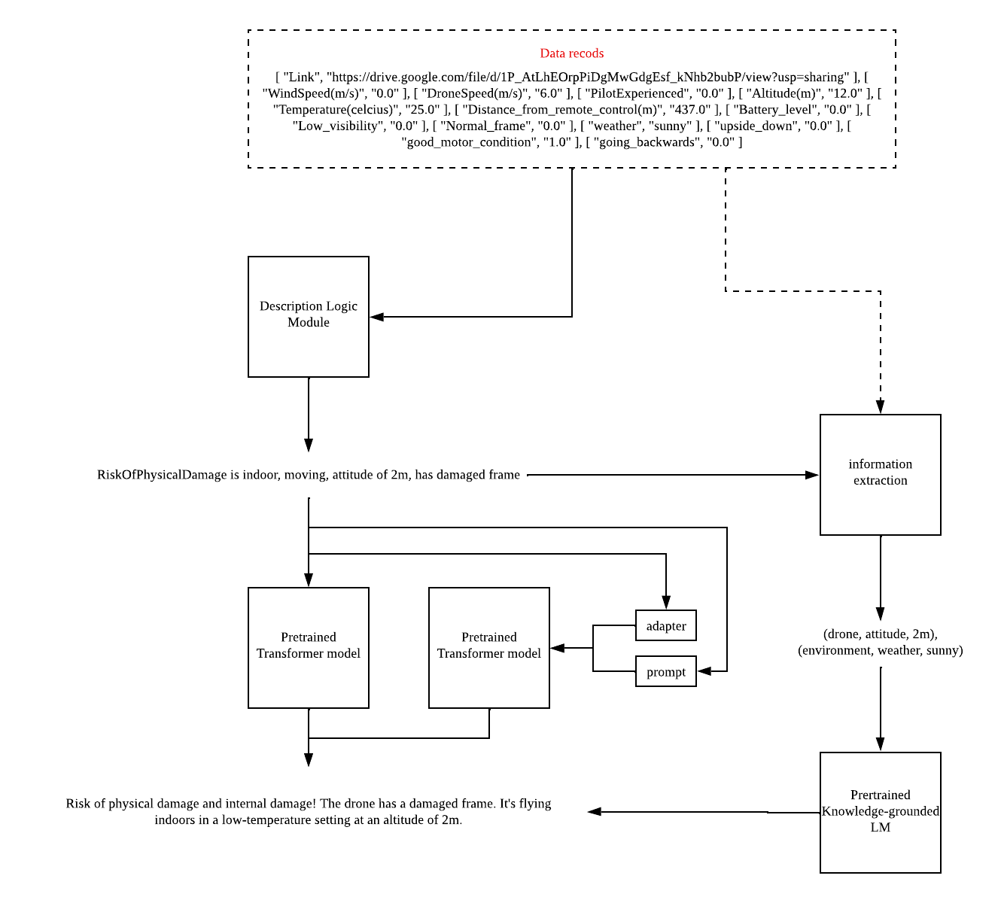
DL+NLG model
Motivation
1. Continue to use DL as content selection module
2. Apply parameter-efficient methods for the limited number of training samples

Slide 21
DL+NLG model
Prompt
Logic-guided retrieval augmented prompt
LoRA
Adapter

Slide 22
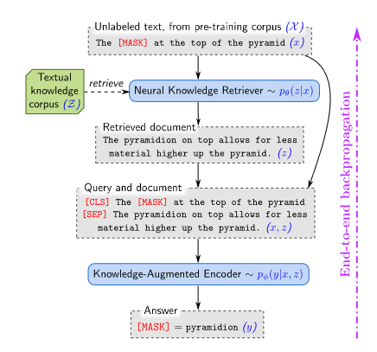
Retrieval-Augmented Generation
Motivation: Knowledge-intensive tasks like open-domain question answering would need to world knowledge to predict the answer. But the world knowledge is implicitly stored in the neural network and limited by the size of network.
Solution: To capture knowledge in a more modular and interpretable way, we augment language model pretraining explicitly with a learned knowledge retriever
Nie E, Liang S, Schimid H et al.
Cross-Lingual Retrieval Augmented Prompt for Low-Resource Languages

Slide 23
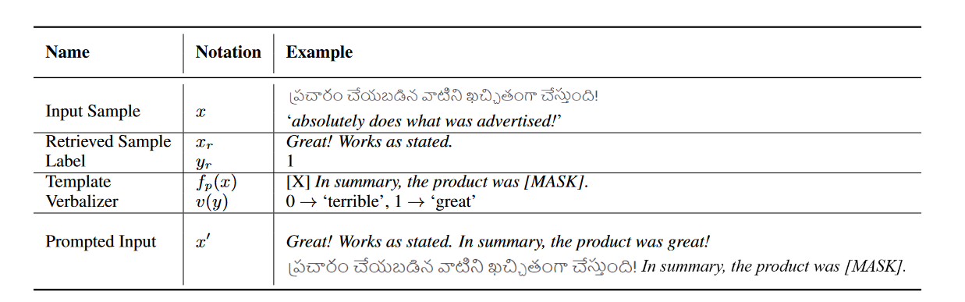
Retrieval augmented prompt by semantically similar sentences
Motivation:
Contextualized representation could capture linguistic expectations about word sense
For example, if a pseudoword interpreted as “in” induces a distribution over its argument slot that gives most of the probability mass to locations such as “London” or “Paris”, w emay conclude that the pseudoword has a locative sense
Nie E, Liang S, Schimid H et al.
Cross-Lingual Retrieval Augmented Prompt for Low-Resource Languages
Notes:
By reformulating the input, the prompt is designed to help PLMs “understand” the task better and recall what has been learned during the pretraining
Improve the zero-shot performance on low-resource languages (LRLs) by augmenting the con-text with semantically similar sentences re-trieved from a high-resource language (HRL)as prompts

Slide 24
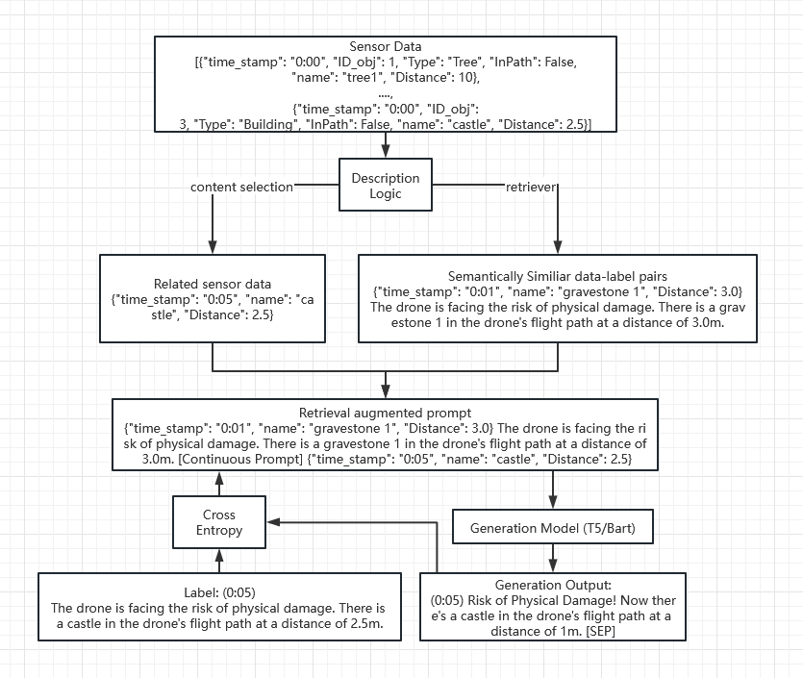
Logic-guided retrieval augmented prompt Aggregation solution: another prompt

Slide 25
Logic-guided retrieval augmented prompt DL as a Retriever
Name | Notation | Example
Related Sensor Data | x | {"time_stamp": "0:05", "name": "castle", "Distance": 2.5}
Retrieved Sample | x_{r} | {"time_stamp": "0:01", "name": "gravestone 1", "Distance": 3.0}
Retrieved text | y_{r} | The drone is facing the risk of physical damage. There is a gravestone 1 in the drone's flight path at a distance of 3.0m.
Prompted Input | x' | {"time_stamp": "0:01", "name": "gravestone 1", "Distance": 3.0} The drone is facing the risk of physical damage. There is a gravestone 1 in the drone's flight path at a distance of 3.0m. [Continuous Prompt] {"time_stamp": "0:05", "name": "castle", "Distance": 2.5}
Expected text |  | The drone is facing the risk of physical damage. There is a castle in the drone's flight path at a distance of 2.5m.
Name | Notation | Example
Related Sensor Data | x | {"time_stamp": "0:05", "name": "castle", "Distance": 2.5}
Retrieved Sample | x_{r} | {"time_stamp": "0:01", "name": "gravestone 1", "Distance": 3.0}
Retrieved text | y_{r} | The drone is facing the risk of physical damage. There is a gravestone 1 in the drone's flight path at a distance of 3.0m.
Prompted Input | x' | {"time_stamp": "0:01", "name": "gravestone 1", "Distance": 3.0} The drone is facing the risk of physical damage. There is a gravestone 1 in the drone's flight path at a distance of 3.0m. [SEP] {"time_stamp": "0:05", "name": "castle", "Distance": 2.5}
Notes:
We Could not only use the Train the continuous prompt by cross-entropy.

Slide 26
Logic-guided retrieval augmented prompt Summarization problem
https://drive.google.com/file/d/1_iqwxrNaYtlcvWkYecEPWoGzoEuX77cd/view?usp=sharing | tree 1 | 1 | Tree | FALSE | TRUE | 5 | 00:03
 | tree 1 | 1 | Tree | FALSE | TRUE | 1 | 00:05
 | tree 1 | 1 | Tree | FALSE | FALSE | 2 | 00:06
 | tree 2 | 2 | Tree | FALSE | TRUE | 10 | 00:08
 | tree 3 | 3 | Tree | FALSE | FALSE | 8 | 00:11
 | tree 4 | 4 | Tree | FALSE | TRUE | 7 | 00:14
 | tree 4 | 4 | Tree | FALSE | FALSE | 1 | 00:16
(0:03) Risk of physical damage! There's a tree in the drone's flight path at a distance of 5m. [SEP] (0:05) Risk of physical damage! Now the tree is in the drone's flight path at a distance of 1m. [SEP] (0:06) Risk of physical damage! Now the tree is only 2m away. [SEP] (0:14) Risk of physical damage! There's another tree in the drone's flight path at a distance of 7m. [SEP] (0:16) Risk of physical damage! Now the tree is only 1m away. [SEP]
Nie E, Liang S, Schimid H et al.
Cross-Lingual Retrieval Augmented Prompt for Low-Resource Languages

Slide 27
Logic-guided retrieval augmented prompt Aggregation solution: another prompt
Name | Notation | Example
Sentence 1 | s₁ | (0:01) The drone is facing the risk of physical damage. There is a gravestone 1 in the drone's flight path at a distance of 3.0m.
Sentence 2 | s₂ | (0:01) The drone is facing the risk of physical damage. There is a gravestone 2 in the drone's flight path at a distance of 3.0m.
Prompted Input | x' | (0:01) The drone is facing the risk of physical damage. There is a gravestone 1 in the drone's flight path at a distance of 3.0m. [Continuous Prompt] (0:01) The drone is facing the risk of physical damage. There is a gravestone 2 in the drone's flight path at a distance of 3.0m.
label | s | (0:01) Risk of physical damage! There are two gravestones 3m away and in the drone's path.

Slide 28
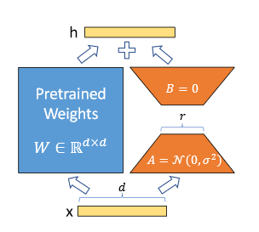
LoRA
Motivation:
We take inspiration from Li et al. (2018a); Aghajanyan et al. (2020) which show that the learned over-parametrized models in fact reside on a low intrinsic dimension. We hypothesize that the change in weights during model adaptation also has a low “intrinsic rank”, leading to our proposed Low-Rank Adaptation (LoRA) approach.
Advantages:
1. LoRA only optimize the injected, much smaller low-rank matrices
2. LoRA is orthogonal to many prior methods and can be combined with many of them, suchas prefix-tuning

Slide 29
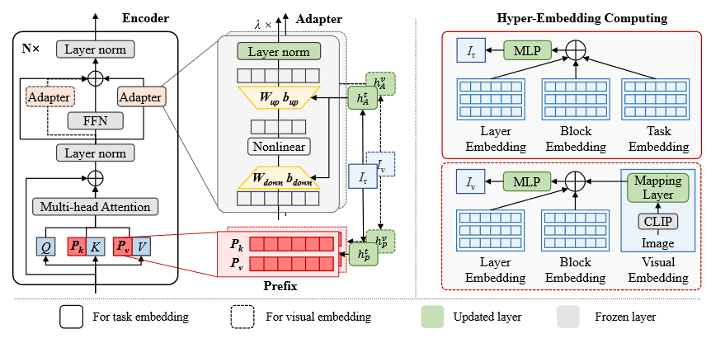
Extension: Modular Multi-modalities
Zhang Z, Guo W, Meng X et al.
HyperPELT: Unified Parameter-Efficient Language Model Tuning for Both Language and Vision-and-Language Tasks

Slide 30
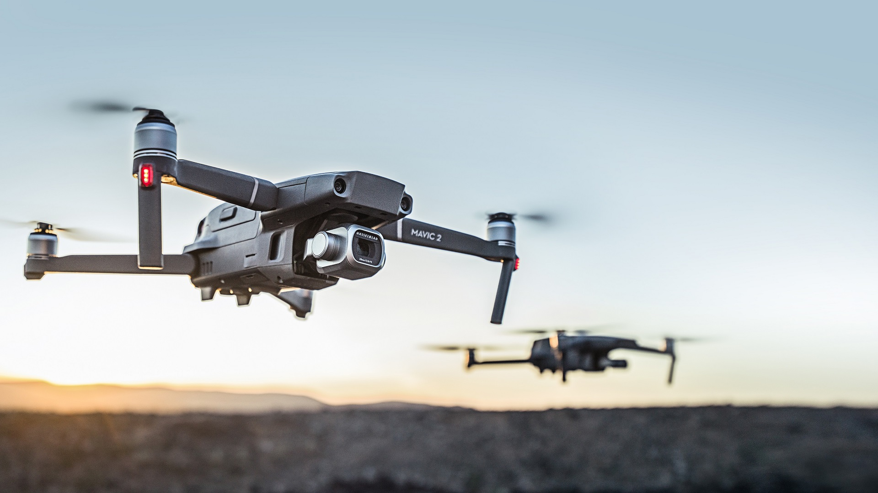
Thank you

Slide 31
Deadline
Conference Name | Submission deadline | Conference date
COLING | *May 17, 2022 | October 12-17, 2022
EACL | *20 October 2022 | Feb 10, 2023
EMNLP | *1 December 2022 | TBD
TACL
ACL |  | July 9-14, 2023

